Slide 2

Cro-Fu
FusionFabric CrowdFunding Platform
Paris Hackathon ‘15

Slide 3
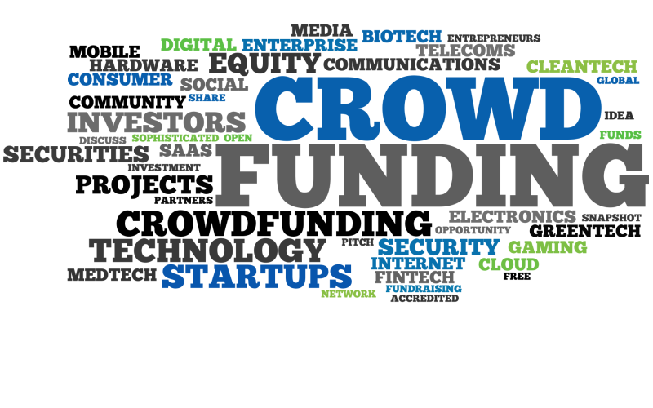
What is CrowdFunding?
Funding of Projects by Individuals
CFPs are Online Lending Exchanges
Many Types of Funded Projects
Donation (Charity, …)
Reward based
Equity based
Debt based (CrowdLending, P2PL)
And … Mortgage

Slide 4

CrowdFunding Market
>1 Million Projects
>1300 Existing Platforms
$34bn in yearly transactions
Banks Scratching the Surface
$1tn target in 2020
1,000,000,000,000
Notes:
Source crowdsourcing.org
http://www.crowdsourcing.org/editorial/global-crowdfunding-market-to-reach-344b-in-2015-predicts-massolutions-2015cf-industry-report/45376
To put this in perspective, Entire US Residential Mortgage is 11tn
Source http://www.federalreserve.gov/econresdata/releases/mortoutstand/current.htm

Slide 5

Why Misys and Fusion Crowdfunding?
Culture
Customer Success Is Central to all we do
High Performance Culture …
Outstanding Financial Performance
Technology
Resilience, Scalability, SaaS ready
Client Base
Notes:
Customer Success is central to all we do : we want banks to tap into this gigantic market
High Performance Culture and great place to work : Challenge to build 24/7 solutions for 100k+ users
Outstanding financial performance : This is a juicy greenfield market for us.

Slide 6

What is the Challenge?
Global Retail Base : 24/7 System
1M+ Users : Highly Scalable
Integration with Banks systems
Web Site
Wire Transfers
Single Sign On
Escrow Accounts
Notes:
The system needs to be designed for a large user base

Slide 7




Demo Architecture

Slide 8
Demo

Slide 9
Conclusion

Slide 10
Takeaways
Market is Ripe
Misys is the Perfect Provider
Show you are a believer

Slide 11
Frederic Andre, Jean-Cedric Jollant, Laurent Lhermine, Yoan Maman Misys CrowdFunding

